Slide 1
WEEK 7 · LECTURE 14
Making It Yours
Part 2: adapting a pretrained model to your own data
How much of your own labelled data does each method need,
and what does each one cost?
Rungs 1 and 2 were Lecture 13. Rung 3 is Week 8. Tonight covers rungs 4 to 7.
ISBA 2411 · Natural Language Processing & AI · Summer 2026

Slide 2
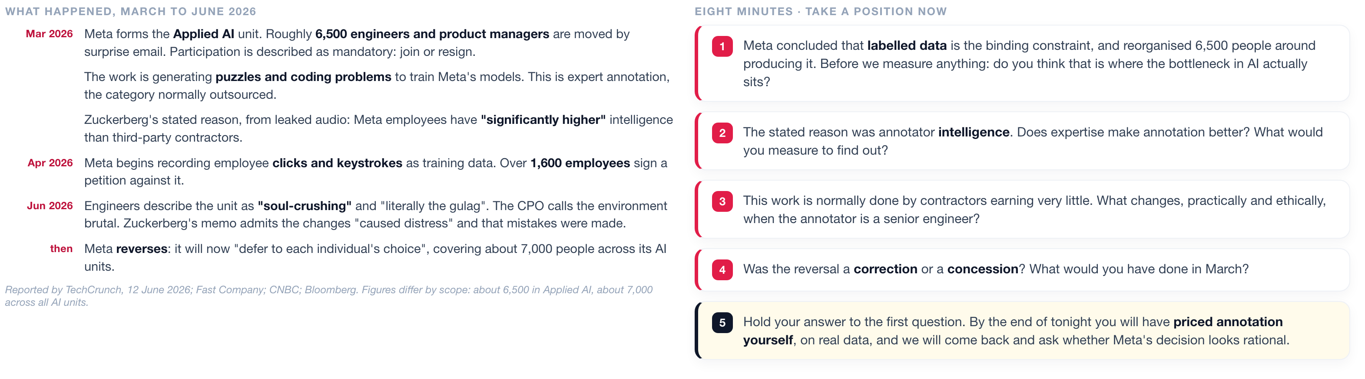
DISCUSSION · BEFORE WE START
Meta moved 6,500 engineers into data annotation
March to June 2026. Tonight is about what labelled data costs. This is that cost at the scale of a company.
ISBA 2411 · Natural Language Processing & AI · Summer 2026

Slide 3
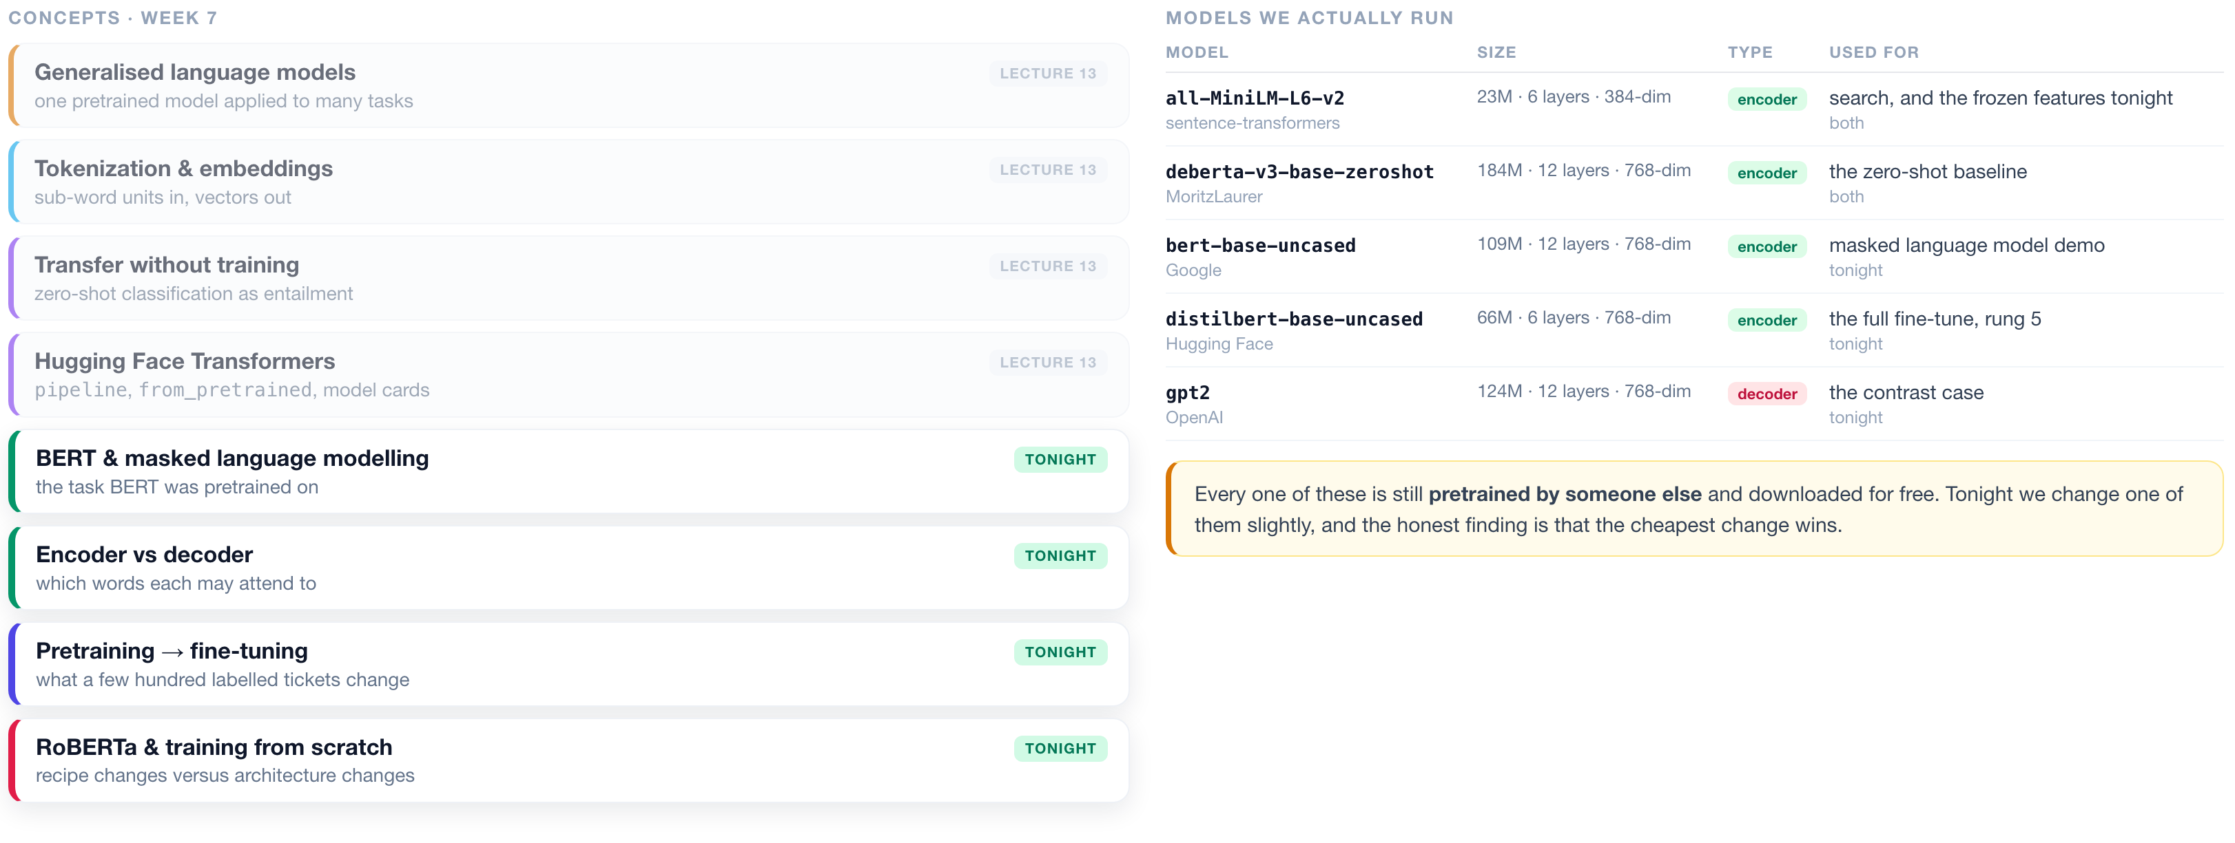
WEEK 7 · AT A GLANCE
Language Models & Transformers
The eight concepts for Week 7 and the five models we run. Greyed out was covered in Lecture 13. The four in green are covered tonight.
ISBA 2411 · Natural Language Processing & AI · Summer 2026

Slide 4
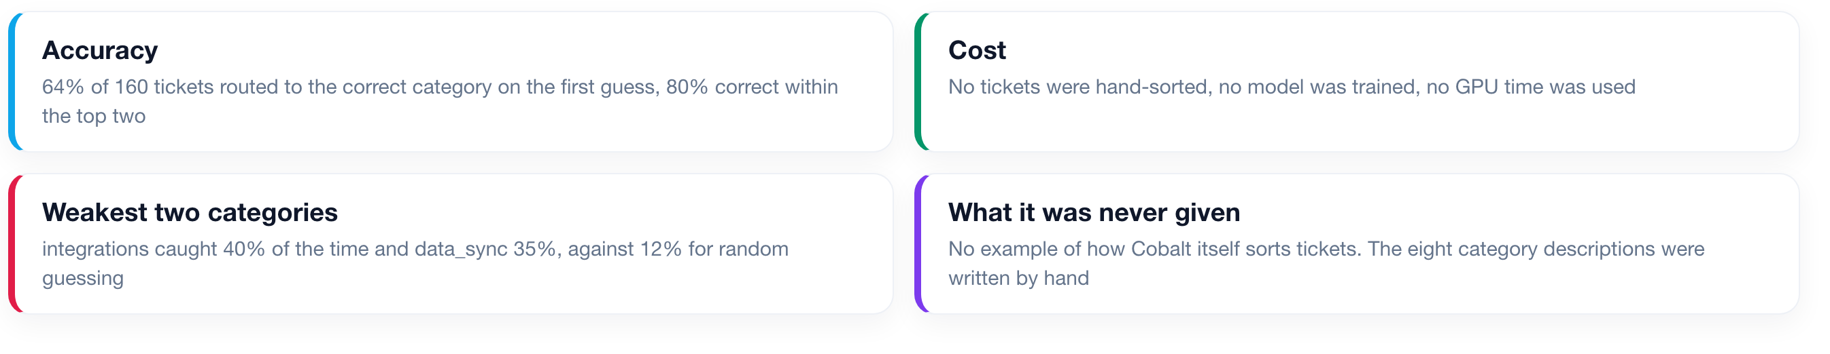
LECTURE 13 RECAP
What the copilot achieved with no training data
Accuracy 64% on the first guess and 80% within its top two, on the same 160 tickets. Two categories were caught less than half the time.
ISBA 2411 · Natural Language Processing & AI · Summer 2026

Slide 5
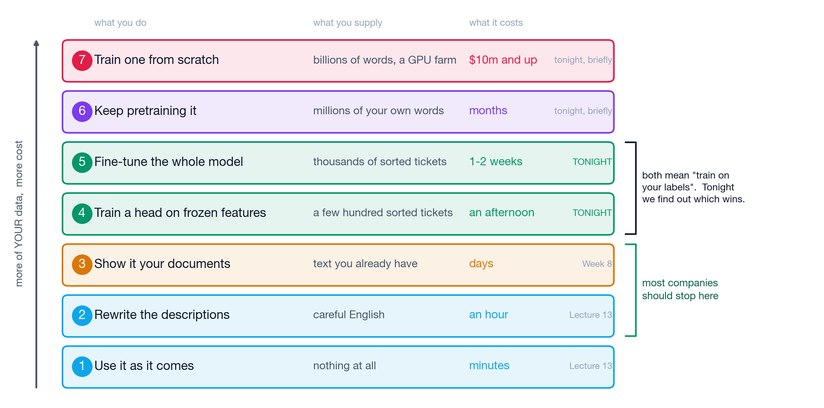
THE ADAPTATION LADDER
Seven ways to adapt a model to your own data
Ordered bottom to top by how much of your own data each one requires, with what each costs. Rungs 1 and 2 were Lecture 13; rung 3 is Week 8; rungs 4 to 7 are tonight.
ISBA 2411 · Natural Language Processing & AI · Summer 2026

Slide 6
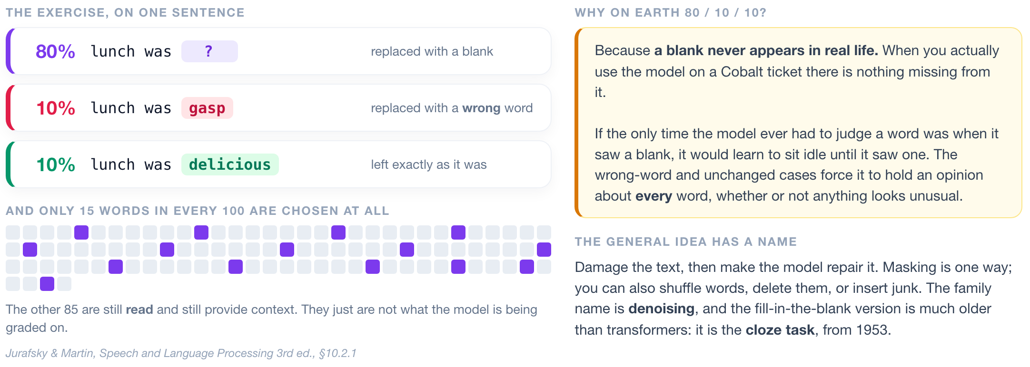
MASKED LANGUAGE MODELLING
1
2
3
4
5
6
7
How BERT was trained to read
15% of the words are chosen. Of those, 80% are replaced with a blank, 10% with a wrong word, and 10% are left unchanged. The right-hand panel explains why.
ISBA 2411 · Natural Language Processing & AI · Summer 2026

Slide 7
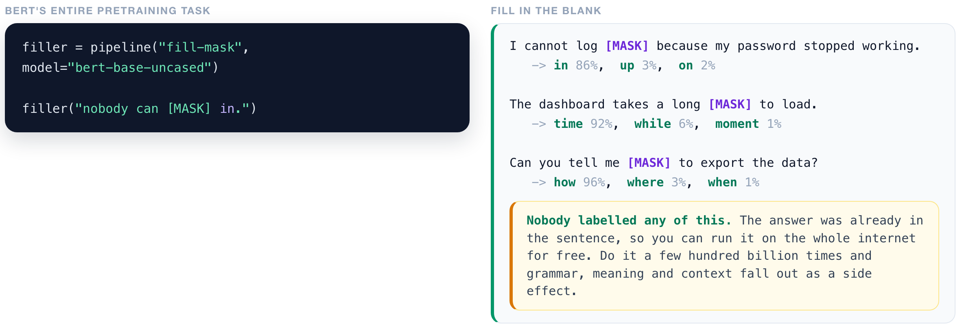
MASKED LANGUAGE MODELLING
1
2
3
4
5
6
7
The fill-in-the-blank task, run live
bert-base-uncased predicting a hidden word from the words around it. No labelled data is needed for this, which is why it could be run on very large amounts of text.
▶ NOTEBOOK
STEP 4
Fill in the blank
ISBA 2411 · Natural Language Processing & AI · Summer 2026

Slide 8
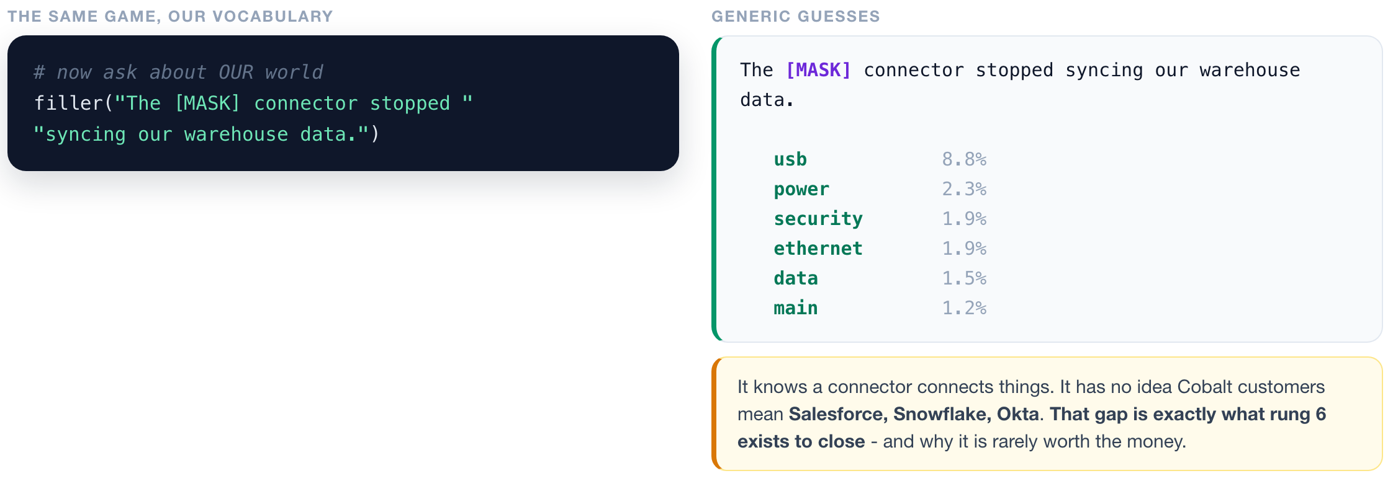
MASKED LANGUAGE MODELLING
1
2
3
4
5
6
7
The same task on product vocabulary
The same model and the same task, asked to fill a blank whose answer is a vendor name it rarely encountered during pretraining.
▶ NOTEBOOK
STEP 5
Fill in the blank on Cobalt jargon
ISBA 2411 · Natural Language Processing & AI · Summer 2026

Slide 9
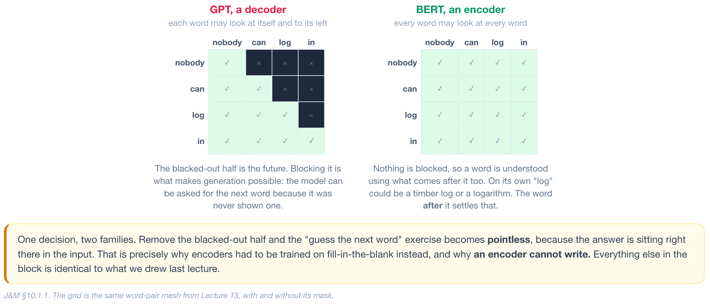
ENCODER AND DECODER MODELS
Which words each model is allowed to look at
Each row is a word doing the looking; each column is a word being looked at. Green is permitted, black is blocked.
ISBA 2411 · Natural Language Processing & AI · Summer 2026

Slide 10
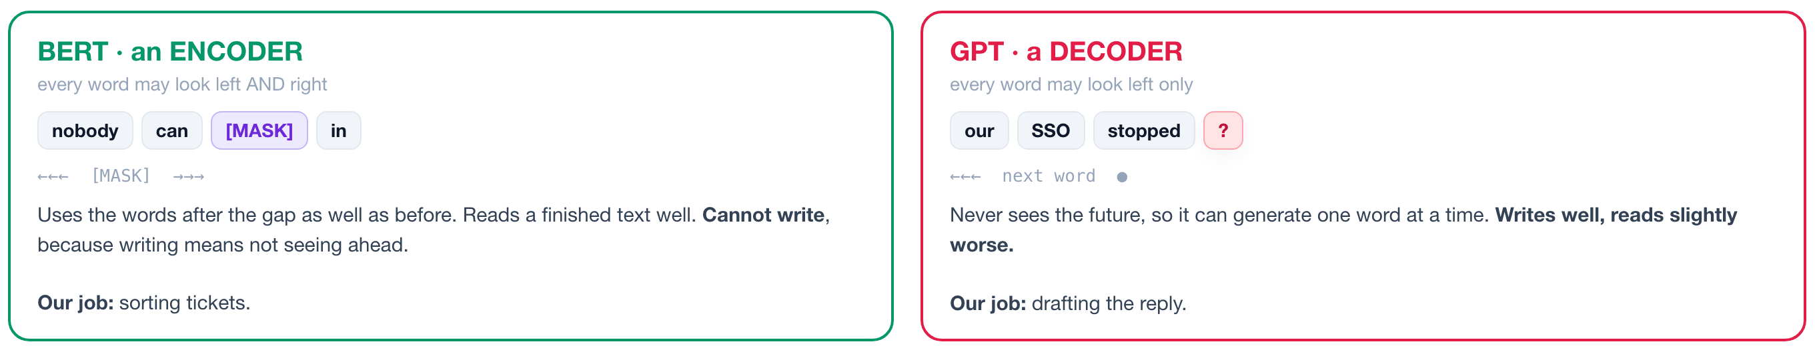
ENCODER AND DECODER MODELS
What each of the two is used for
Both use the transformer block from Lecture 13. The only difference is whether a word may look at the words to its right.
▶ NOTEBOOK
STEP 6
Why BERT reads and GPT writes
ISBA 2411 · Natural Language Processing & AI · Summer 2026

Slide 11
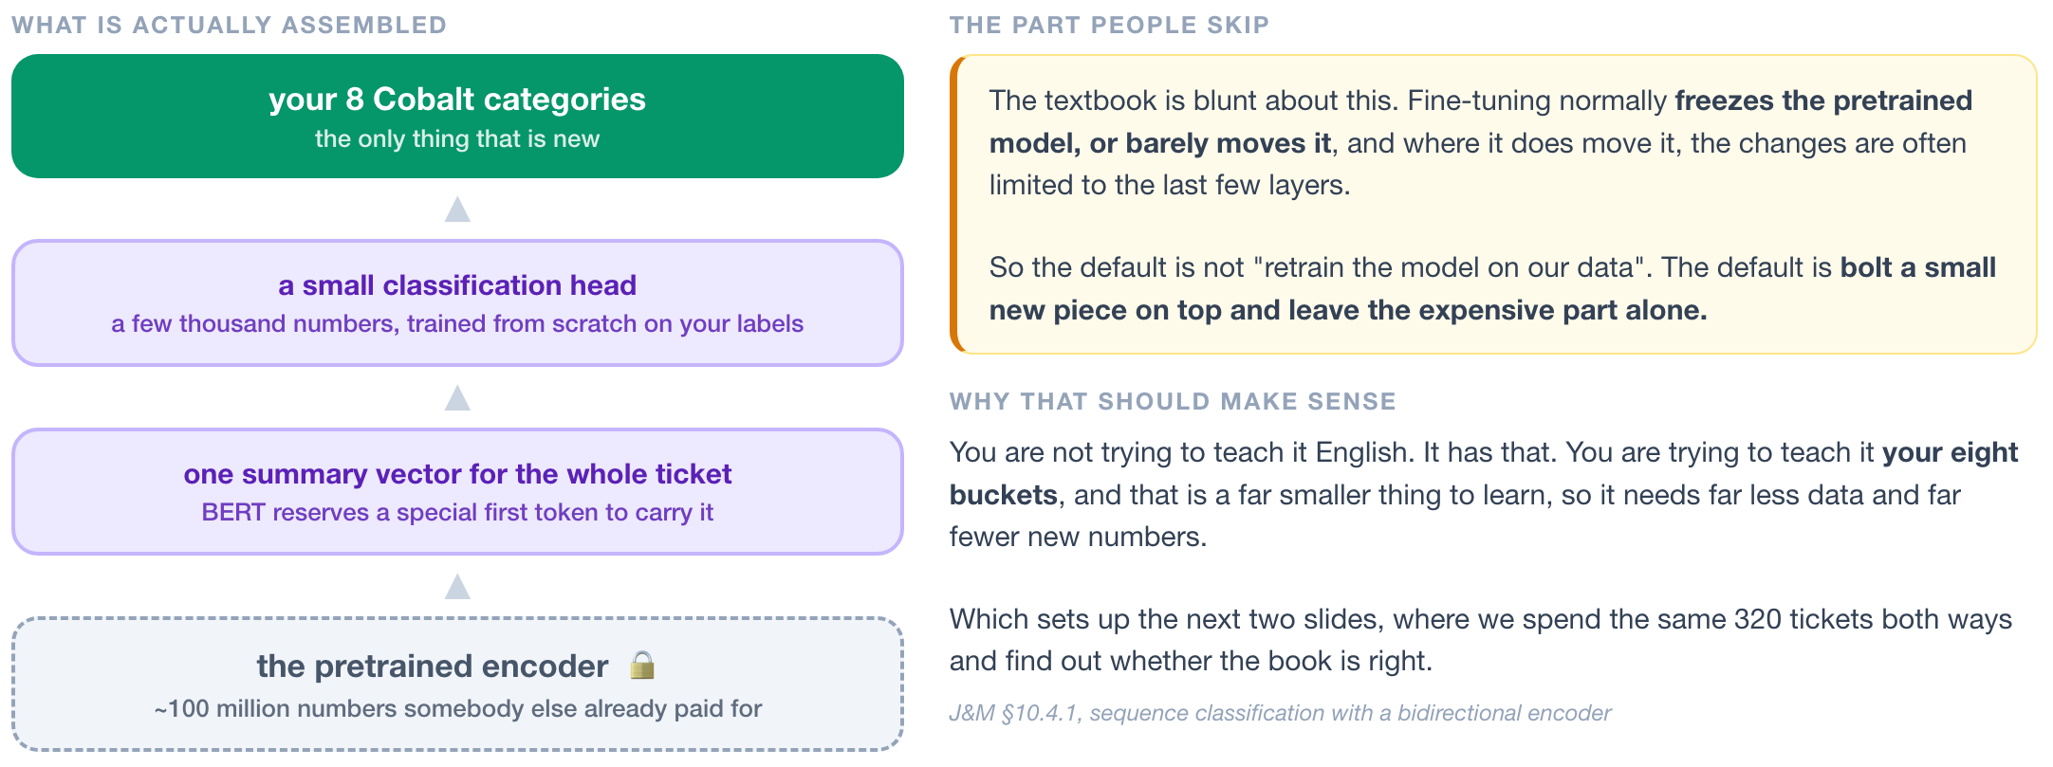
PRETRAINING AND FINE-TUNING
1
2
3
4
5
6
7
What fine-tuning actually changes
A small classifier is added on top of the pretrained encoder. The textbook default is to leave the encoder frozen, or to change only its last few layers.
ISBA 2411 · Natural Language Processing & AI · Summer 2026

Slide 12
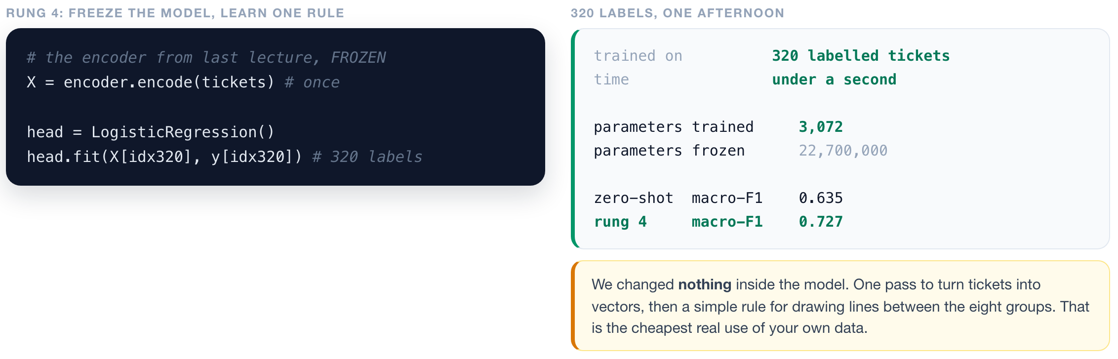
RUNG 4
1
2
3
4
5
6
7
Freeze the encoder, train only the head
320 labelled tickets. 3,072 new parameters are trained and 22.7 million are left unchanged. Macro-F1 goes from 0.635 to 0.727.
▶ NOTEBOOK
STEP 9
RUNG 4: train a head on 320 labels
ISBA 2411 · Natural Language Processing & AI · Summer 2026

Slide 13
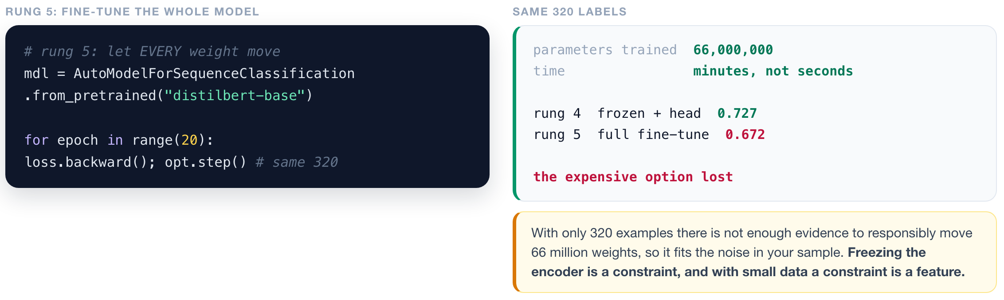
RUNG 5
1
2
3
4
5
6
7
Fine-tune all 66 million parameters
The same 320 tickets, but every weight in the model may change. Write down your prediction before the result is shown.
▶ NOTEBOOK
STEP 10
RUNG 5: fine-tune the whole model
ISBA 2411 · Natural Language Processing & AI · Summer 2026

Slide 14
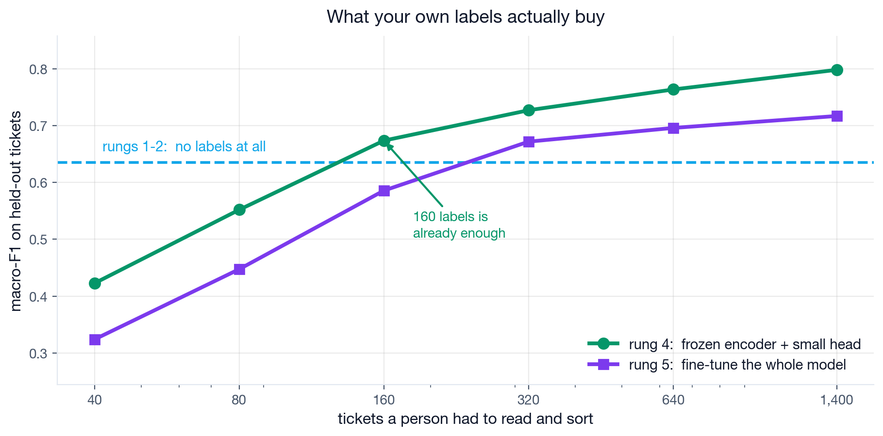
LABELLING BUDGET
1
2
3
4
5
6
7
Accuracy against number of labelled tickets
Both rungs at six budgets, measured on the 160 held-out hand-written tickets. Averaged over several runs per point.
Rung 4 scores higher than rung 5 at every budget shown. Both curves flatten: going from 640 to 1,400 labels adds only 0.035 macro-F1.
▶ NOTEBOOK
STEP 11
The learning curve
ISBA 2411 · Natural Language Processing & AI · Summer 2026

Slide 15
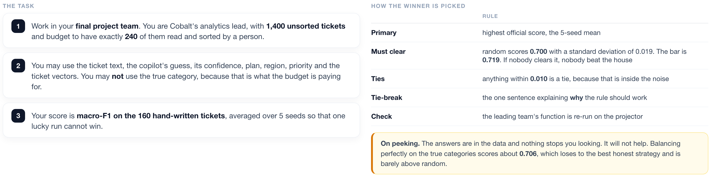
IN-CLASS EXERCISE
Choose which 240 of 1,400 tickets to label
Final project teams. Same budget for every team. Scored on held-out tickets, averaged over 5 seeds.
▶ NOTEBOOK
STEP 13
THE GAME: your labelling budget
ISBA 2411 · Natural Language Processing & AI · Summer 2026

Slide 16
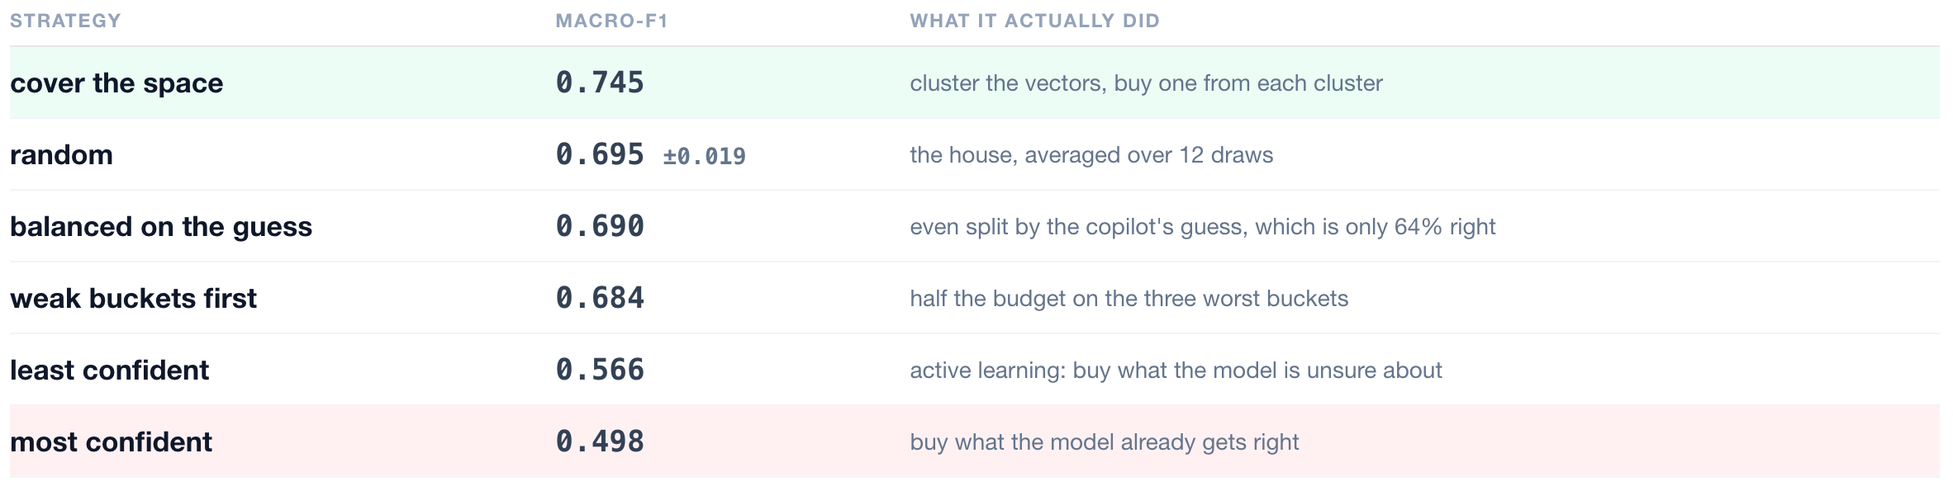
RESULTS
Six selection strategies at the same 240-label budget
Same model and same training code throughout. Only the choice of which tickets to label changed.
A range of 0.247 macro-F1 at identical cost. Only 'cover the space' scored above random plus one standard deviation. Every strategy that ranked tickets by a score scored below random.
ISBA 2411 · Natural Language Processing & AI · Summer 2026

Slide 17
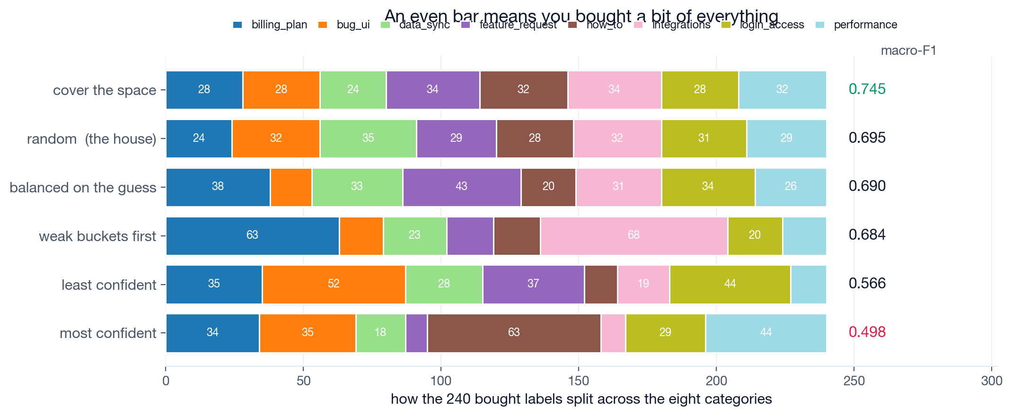
RESULTS
How each strategy spent its 240 labels
One bar per strategy, split by category, sorted by score. An even bar means the strategy bought some of every category.
No strategy was allowed to balance on the true categories, since those are what the budget buys. Clustering the ticket vectors produced an even spread without using any label.
▶ NOTEBOOK
STEP 19
Why the winner won
ISBA 2411 · Natural Language Processing & AI · Summer 2026

Slide 18
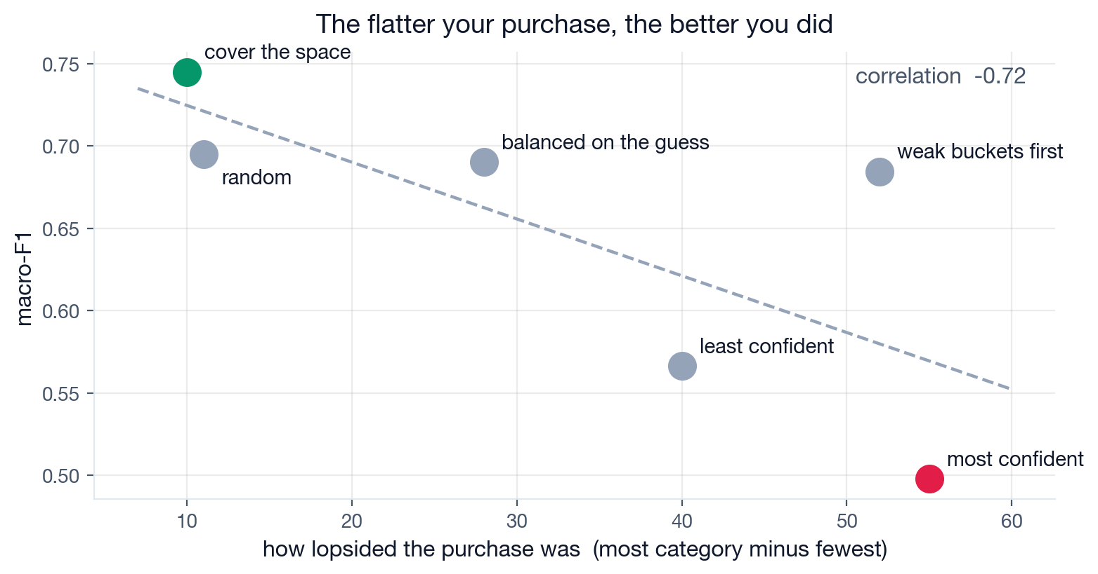
RESULTS
Lopsided purchases scored lower
Horizontal axis is the largest category count minus the smallest. Correlation with macro-F1 across all six strategies is -0.72.
The rule used to select training data also determines its class distribution. Any rule that sorts by a score will skew that distribution, so check the mix before training.
ISBA 2411 · Natural Language Processing & AI · Summer 2026

Slide 19
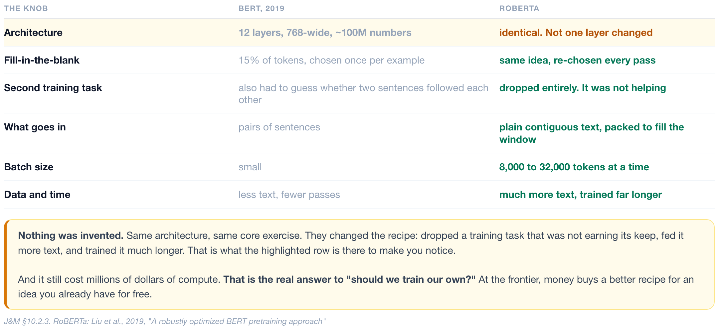
ROBERTA
1
2
3
4
5
6
7
What RoBERTa changed, and what it did not
The architecture is unchanged. The training recipe changed: one objective dropped, larger batches, more text, longer training.
ISBA 2411 · Natural Language Processing & AI · Summer 2026

Slide 20
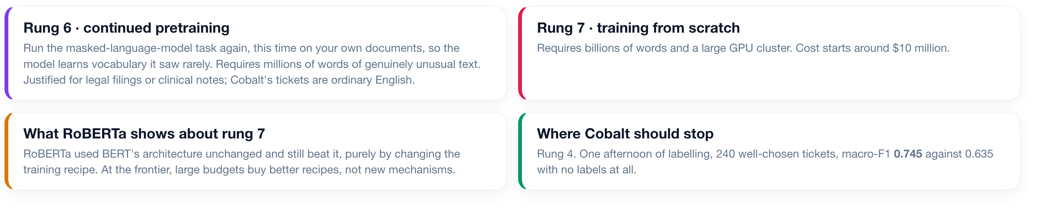
RUNGS 6 AND 7
1
2
3
4
5
6
7
What the top two rungs cost
Continued pretraining and training from scratch: what each requires, when each is worth doing, and why the answer for Cobalt is neither.
▶ NOTEBOOK
STEP 20
RUNGS 6 and 7: should Cobalt train its own?
ISBA 2411 · Natural Language Processing & AI · Summer 2026

Slide 21
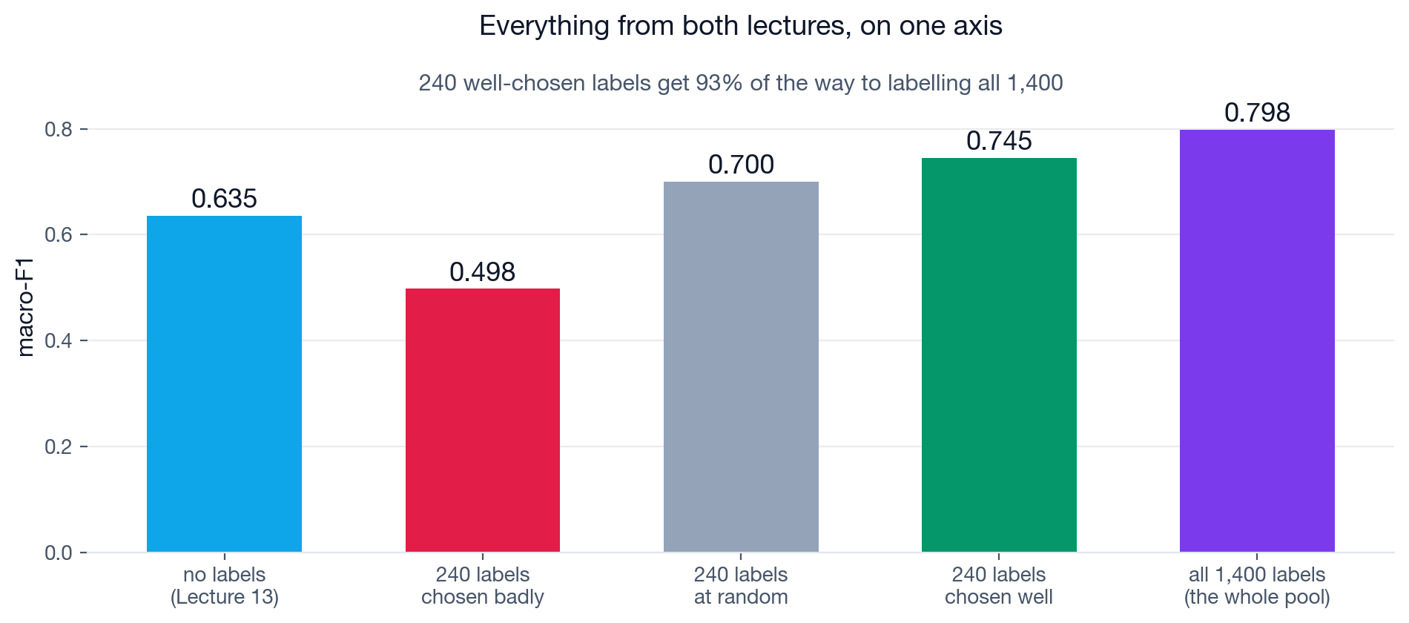
SUMMARY
Every result from both lectures on one axis
Macro-F1 with no labels, with 240 labels chosen badly, 240 chosen at random, 240 chosen well, and with all 1,400 labelled.
240 labels chosen well reached 93% of the score obtained by labelling all 1,400 tickets.
ISBA 2411 · Natural Language Processing & AI · Summer 2026

Slide 22
SUMMARY
Four things you can apply at work
1
Plot the learning curve before committing to a labelling project
Label a few hundred examples, plot the score against the number of labels, and find where the curve flattens. That point, not a fixed target, is where labelling should stop.
2
Test the frozen-encoder option before approving a fine-tune
Frozen embeddings with a simple classifier is faster and cheaper, and at these data sizes it scored higher. Require the more expensive option to demonstrate an improvement.
3
Check the class distribution of the training data you selected
The selection rule determines the class mix, and the class mix determines where the model will fail. Inspect the counts per category before training.
4
Ask which adaptation methods have already been tried
When training a model from scratch is proposed, establish first what rungs 1 through 5 scored. Also ask what random selection scored before accepting any clever selection method.
ISBA 2411 · Natural Language Processing & AI · Summer 2026

